Slide 1
MSc DABI Project Module code - MA7098
Predicting customer behavior on credit card receivables with the effect of macroeconomic variables

Slide 2
Content
Project Overview
Data Collection
Data Preprocessing
Exploratory Data Analysis
Feature Selection
Feature Engineering
Modeling and Optimization
Results and Conclusion
About Variables

Slide 3
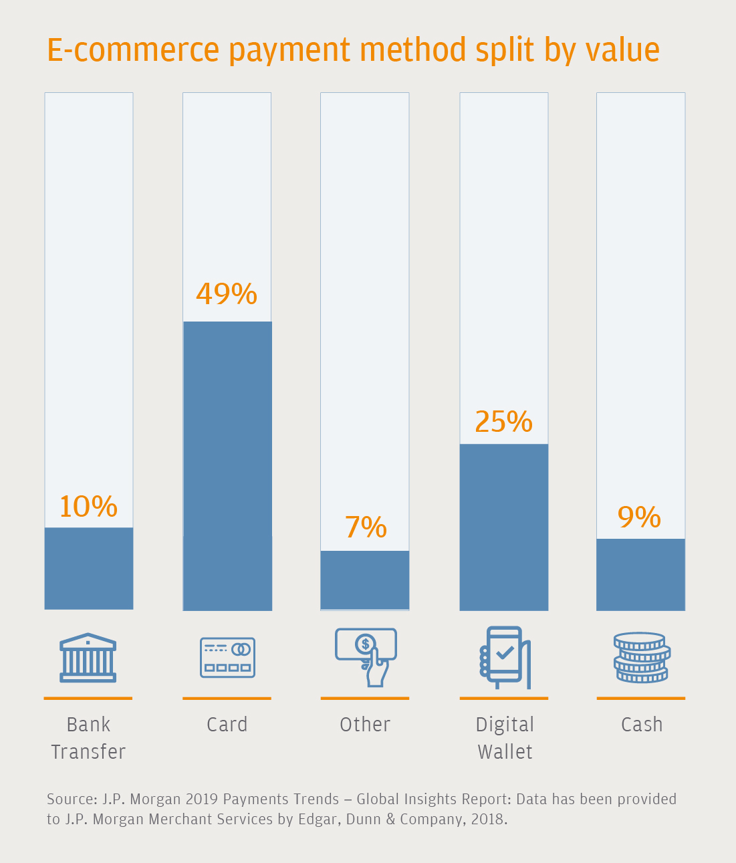
Project Overview
Cards are the leading way to shop online in Hong Kong
The payment market is dominated by credit cards, with Visa®, Mastercard®, and American Express all well-utilized and recognized brands.
According to J.P. Morgan 2019 Payments Trends, ownership of credit cards(2.67 credit cards per capita) in Hong Kong significantly outweighs debit cards(0.81 debit cards per capita)
credit card receivables from individual credit card holders.
Culture of paying with credit cards
for domestic bills and daily transport
an appetite for rewards linked to credit card use, such as cashback and air miles programs
To capitalize cross-border spending with China, the domestic banks offer multi-currency cards that allow payments to be settled in a choice of currencies

Slide 4
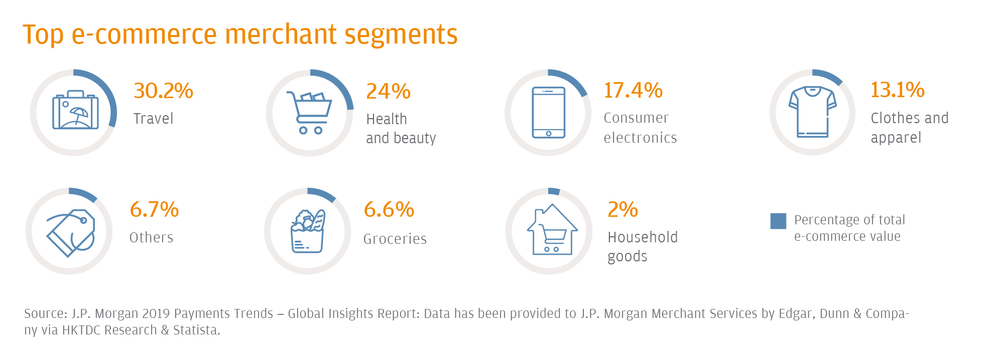
Project Overview
Hong Kong is a highly banked, wealthy region that enjoys excellent digital and physical infrastructure, both of which will support future e-commerce growth.
Online shopping market is projected to expand as Hong Kong is notable for its advanced e-commerce infrastructure and good e-commerce growth potential.

Slide 5
Project Overview
Growth potential(challenge and opportunity for merchants to meet customer expectations around delivery, and to expand their business smoothly):
a) majority of the population is yet to even use e-commerce
b) Only a quarter of Hong Kong’s citizens currently shop online
c) 75% smartphone penetration, 95.3% Bank account penetration
d) 89.4% Internet penetration, the highest of the non-European countries included in JP Morgan report.
d) In 2018, Hong Kong chief executives said they were planning to increase investment in their
e-commerce and online sales operations by 20 percent or more.
e) When online shopping demand increases, the infrastructure is already in place to meet higher delivery volumes. (Hong Kong is placed 12th in the World Bank’s global ranking of logistics capabilities and quality)

Slide 6
Data Collection Hong Kong
Economic & Financial Data for Hong Kong
Collected several data files for Hong Kong(45 excel files)
Referred to multiple websites and all the links were attached to the project management tool for future references.
Most of the data was downloaded from official government websites of respective countries.
Hong Kong Monetary Authority(HMKA)
The government authority is responsible for maintaining monetary and banking stability in Hong Kong.
https://www.hkma.gov.hk/eng/data-publications-and-research/data-and-statistics/economic-financial-data-for-hong-kong/
https://www.hkma.gov.hk/eng/data-publications-and-research/data-and-statistics/monthly-statistical-bulletin/

Slide 7

Macroeconomic Variables
Gross Domestic Product(GDP)
Private consumption expenditure
Government consumption expenditure
Gross domestic fixed capital formation
Changes in inventories
Exports of goods (f.o.b.)
Exports of services
Imports of goods (f.o.b.)
Imports of services
Unemployment Rate (%)
Interest rate (%)
Researched on all types of macroeconomic variables. Collected research papers/articles/journals etc.
Findings/Understanding:
Knowledge on how macroeconomic variables affect the banking industry – how it will affect the different fees of certain products.

Slide 8
Variables from credit card lending survey results
Credit Card - Total no of accounts (million)
Credit Card – Delinquent Amount (>90days) (HK$ million)
Credit Card - Charge off Amount (HK$ million)
Credit Card - Rollover Amount (HK$ million)
Credit Card - Average Total Receivables (HK$ million)
This survey covers authorized institutions (AIs) and some subsidiaries of AIs that are engaged in credit card business.

Slide 9

Introducing variables
Gross Domestic Product(GDP):
Gross domestic product (GDP) is the monetary value of all finished goods and services made within a country during a specific period.
GDP is often used as a metric for international comparisons as well as a broad measure of economic progress.
Considered to be the "world's most powerful statistical indicator of national development and progress”
Private consumption expenditure:
Consumer spending on goods and services.
Measures purchases made by consumers, such as food, housing (rents), energy, clothing, health, leisure, education, communication, transport as well as hotels and restaurant services, durable goods (such as cars)
Government consumption expenditure:
Current expenditure by general government bodies on services to the community such as defence, education, and public order and safety.
The government is considered to be the consumer of its own output because these are provided free of charge or at charges which cover only a small proportion of costs.
Gross domestic fixed capital formation:
Also called "investment“
Defined as the acquisition of produced assets (including purchases of second-hand assets), including the production of such assets by producers for their own use, minus disposals.
Gross Domestic Product(GDP)
Private consumption expenditure
Government consumption expenditure
Gross domestic fixed capital formation
Changes in inventories
Exports of goods (f.o.b.)
Exports of services
Imports of goods (f.o.b.)
Imports of services
Unemployment Rate (%)
Interest rate (%)
Credit Card - Total no of accounts
Credit Card – Delinquent Amount (>90days)
Credit Card - Charge off Amount
Credit Card - Rollover Amount
Credit Card - Average Total Receivables

Slide 10
Introducing variables
Gross Domestic Product(GDP)
Private consumption expenditure
Government consumption expenditure
Gross domestic fixed capital formation
Changes in inventories
Exports of goods (f.o.b.)
Exports of services
Imports of goods (f.o.b.)
Imports of services
Unemployment Rate (%)
Interest rate (%)
Credit Card - Total no of accounts
Credit Card – Delinquent Amount (>90days)
Credit Card - Charge off Amount
Credit Card - Rollover Amount
Credit Card - Average Total Receivables
Changes in inventories:
Difference between the amount of last period's ending inventory and the amount of the current period's ending inventory.
Exports and imports of goods (f.o.b.):
F.o.b means free on board.
If terms of delivery of a transaction is on FOB means, the cost of movement of goods on board of Airlines or on board of ship is borne by the seller. The rest of all expenses to arrive the goods at buyer's premise has to be met by the buyer.
Exports and Imports of services:
Service exports are an important emerging trend in global trade.
The services where we can’t see the product physically.
Unemployment Rate (%):
The unemployed are people of working age who are without work, are available for work, and have taken specific steps to find work.
The unemployment rate represents the number of unemployed as a percentage of the labor force.

Slide 11
Introducing variables
Credit Card - Total no of account
Credit Card - Average Total Receivables
Credit card receivables in the survey refer to credit card receivables from individual credit cardholders.
Credit Card – Delinquent Amount (>90days)
Takes into account those credit card receivables that at the reporting date had been overdue for more than 90 days but had not yet been written off.
Credit Card - Charge off Amount
Receivables that were written off during the specified period because they were seriously overdue (e.g. for more than 180 days) plus
Receivables those written off earlier than 180 days because they were considered irrecoverable (e.g. because the borrower has gone into bankruptcy).
Credit Card - Rollover Amount
It is the amount within total receivables in respect of which the cardholder has not fully repaid the statement balance but has at least made the minimum amount of payment required by the AI.
It does not include amounts that are overdue.
An account is overdue when the minimum payment is not made upon the due date.
Gross Domestic Product(GDP)
Private consumption expenditure
Government consumption expenditure
Gross domestic fixed capital formation
Changes in inventories
Exports of goods (f.o.b.)
Exports of services
Imports of goods (f.o.b.)
Imports of services
Unemployment Rate (%)
Interest rate (%)
Credit Card - Total no of accounts
Credit Card – Delinquent Amount (>90days)
Credit Card - Charge off Amount
Credit Card - Rollover Amount
Credit Card - Average Total Receivables

Slide 12
Data Preprocessing
Followed the below steps for Data Cleaning:
Removing Duplicates
Structuring the rows/columns
Handling missing values
Manipulating data – Averaging the values
Data Frequency – Quarterly
Data Period – 22 years (2000 to 2021)
Number of variables – 16
Aggregating the data for the analysis requirement
Validate and Quality assurance
On average raw data files consists of 600-800 rows and 12-15 columns.

Slide 13
Exploratory Data Analysis
Exploratory Data Analysis
Box Plot
Summary analysis – Mean, Median, Mode, Variance, Skewness, Kurtosis
Line Plot
Scatter Plot
Correlation Plot – Heatmap

Slide 14
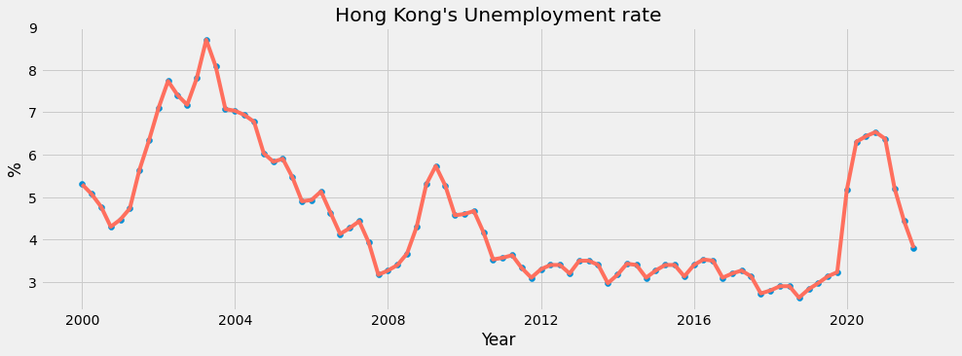
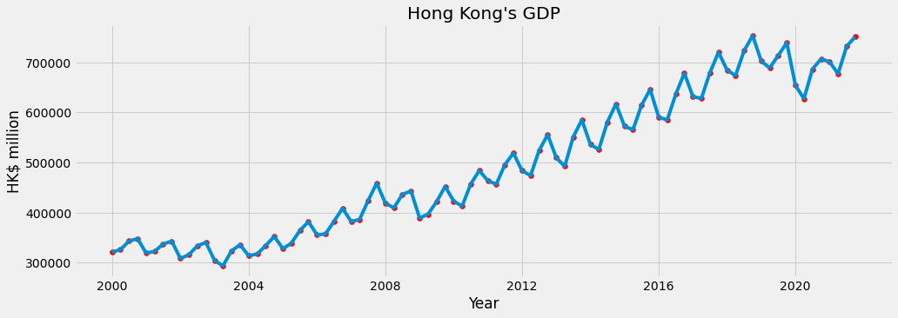
Hong Kong’s Economy & Unemployment Rate
2002–2003
We can observe that there is a spike during 2002-03, which is due to SARS and Economic Crisis in HK.
GDP of the country had drastically fallen in early 2020 due to covid situations.
2009–2010
There is another spike in during 2009-10, which is due to Global Financial Crisis.
2020–2021
Again, we can see a similar spike during 2020-21, which is due to Covid-19.
GDP of the country had drastically fallen in early 2020 due to covid situations.

Slide 15
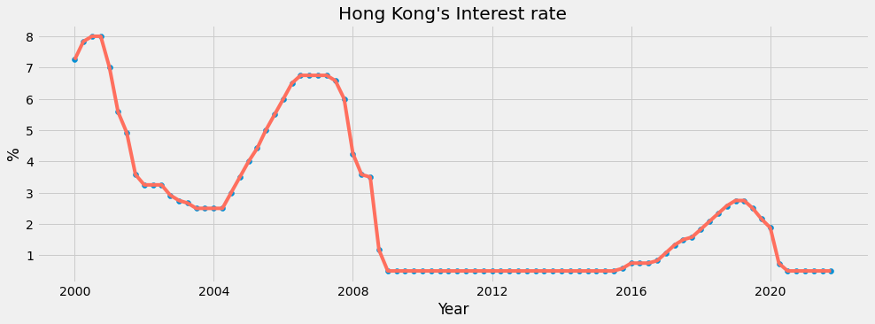
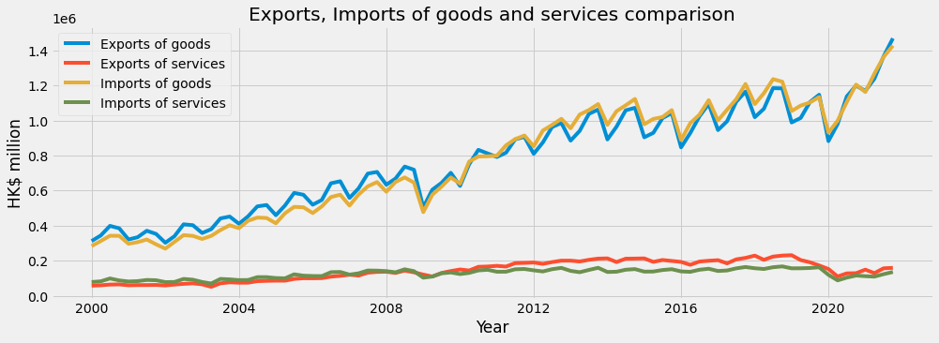
Hong Kong’s Interest rate, Exports and Imports of Goods and services comparison
Beginning in 2000, Hong Kong’s Exports of goods remained higher than the Imports of goods while service exports remained lower than the service imports
2007 -2010, both service exports and imports almost leveled up to the same amount
Post 2010, Hong Kong sees growth in its service exports while the good exports went down compared to good imports.
Both exports and imports of goods had drastically fallen during 2009-10 and 2020 which is due to Global Financial Crisis and Covid outbreak respectively

Slide 16
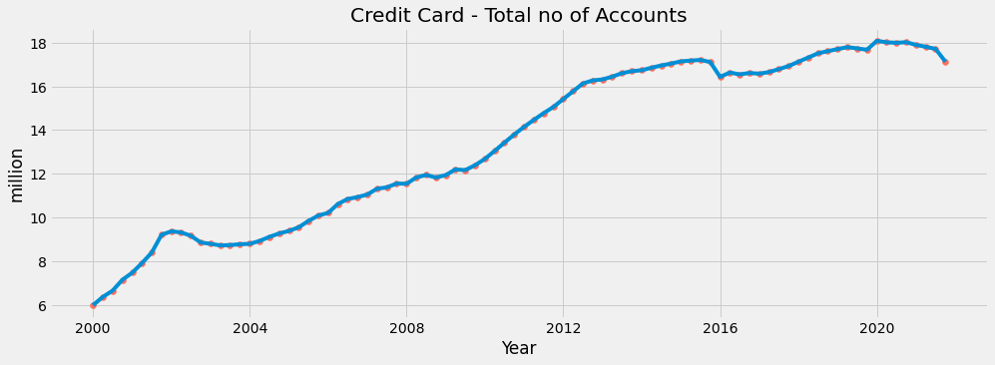
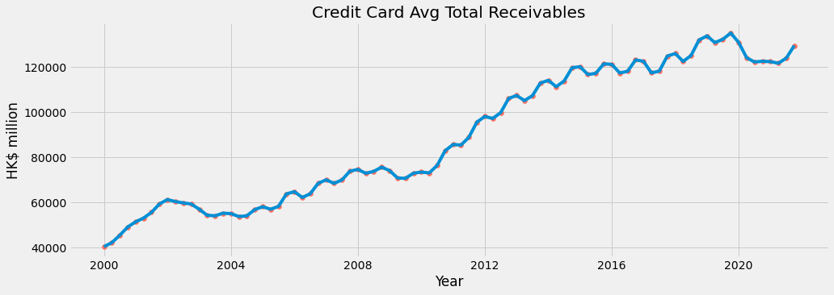
Hong Kong’s Total credit cards and Receivables
Card receivables increased in the fourth quarter to HK$130000 million(130 billion) at the end-December 2021, mainly driven by festive spending and salaries tax payment

Slide 17
Hong Kong’s response to Corona Virus outbreak
Did Hong Kong learn anything after the SARS epidemic(2002-2004)?
A "zero-COVID" elimination strategy
closing all its borders and, until February 2022, subjecting even mild and asymptomatic cases to hospitalization, and sometimes isolation extending over several weeks.
22 January’ 2020
Hong Kong confirmed its first case of the new coronavirus
23rd January’ 2020
1) The Hong Kong government designated the Lady MacLehose Holiday Village in Sai Kung as a quarantine centre.
24th January’ 2020
Health authorities confirmed three more cases
25th January’ 2020
2) The Hong Kong Tourism Board canceled the Lunar New Year Cup and a four-day Lunar New Year carnival, citing concerns over the virus outbreak
From 30th January’ 2020
28th January’ 2020
1) The Hong Kong government declared the viral outbreak as an "emergency" – the highest warning tier.
26th January’ 2020
Earmarked an unoccupied public estate as a quarantine facility for people who may have been exposed to Wuhan coronavirus.
Chief Executive of Hong Kong Carrie Lam announced enhanced measures to stop the novel coronavirus’ spread
1) High-speed rail service between Hong Kong and mainland China was suspended
2) Closed the city's largest amusement parksuntil further notice
3) Primary and secondary schools suspended further.
2) All cross-border ferry services, flights and cross-border bus services from mainland China were reduced by 50%
3) The government also appealed to employers to make flexible work arrangements for employees in accordance with their operational needs.

Slide 18
Hong Kong’s response to Corona Virus outbreak
Did Hong Kong learn anything after the SARS epidemic(2002-2004)?
Behavioural changes such as wearing masks in public since the SARS epidemic of 2003 may have helped keep its confirmed infections at 845, with four deaths, by the beginning of April.
Critical thinking of citizens who have become accustomed to distrusting the competence and political motivations of the government, the World Health Organization, and the Chinese Communist Party.
Border restrictions, quarantine and isolation, social distancing
Proximity to China and its millions of mainland visitors annually
Status as an international transport hub

Slide 19
Hong Kong response to Corona Virus outbreak
First wave
1) Hong Kong relatively unscathed by the first wave of the COVID-19 outbreak
2) Flatter epidemic curve than most other places
Second wave
1) Smaller second wave in March and April 2020
Third wave
1) uptick in COVID cases in July, with more than a hundred cases being reported several days in a row until early August
2) Imported cases – sea crew, aircrew members, and domestic helpers made up the majority of 3rd wave infections.
Fourth Wave
1) Late November 2020
2) A group of dance clubs in which wealthy, female Hong Kongers danced together and had dance lessons with mostly younger male dance instructors.
Fifth wave
1) Driven by Omicron variant in late December 2021
2) Most deaths recorded among the unvaccinated elder population
3) Experts questioned the zero-COVID strategy (low COVID-19 vaccination rate in the city)
2) Caused by overseas returnees rushing to beat mandatory quarantine

Slide 20
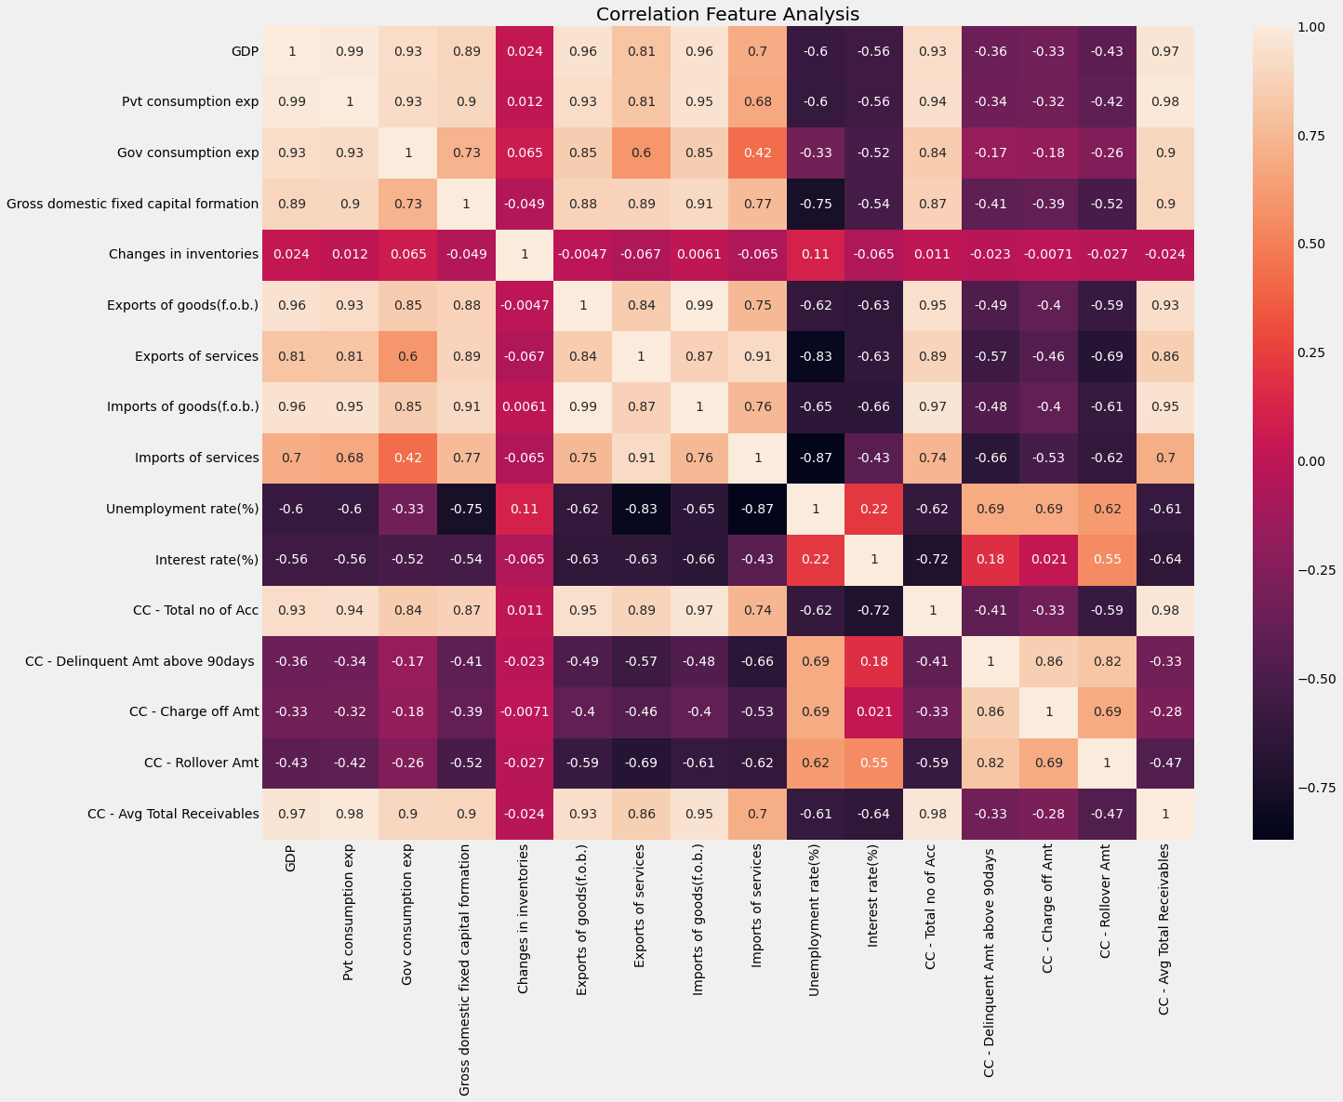
Correlation Matrix
Checking correlation is a part of the EDA process
Tried to check the correlation between the different variables.
As we can see there is a good correlation between the variables in the whole data.
We need to perform feature selection and engineering for selecting inputs for modelling.

Slide 21
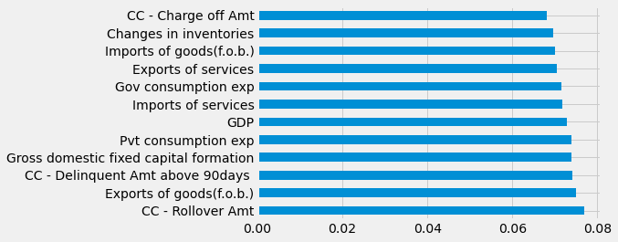

Feature Selection
Based on Feature Importance
Feature importance gives a score for each feature of the data
The higher the score more important or relevant is the feature towards target variable.
Feature importance is an inbuilt class that comes with Tree-Based Classifiers
Feature selection with help of Extratree Classifier(from sklearn.ensemble import ExtraTreesClassifier)
Used Extra Tree Classifier for extracting the top 12 features for the dataset.
Graph of feature importance
Notes:
PCA is a dimension technique. The first PC is a linear combination of correlated variables which explains the maximum variance. The second PC is a linear combination of correlated variables which explains the second largest variance and is uncorrelated with the first one. It is a feature extraction technique.

Slide 22
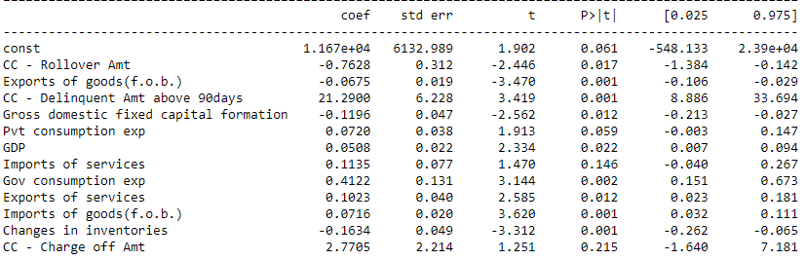
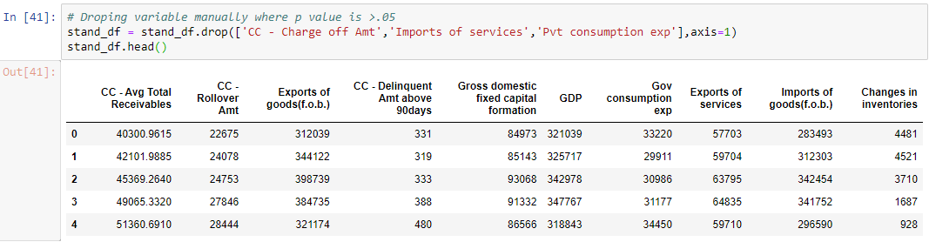
Feature Selection
Based on how they affect the p-value.
Developed an OLS model and calculated p-values.
If the p values are higher than 0.05, then the variable is not statistically significant.
Notes:
PCA is a dimension technique. The first PC is a linear combination of correlated variables which explains the maximum variance. The second PC is a linear combination of correlated variables which explains the second largest variance and is uncorrelated with the first one. It is a feature extraction technique.

Slide 23
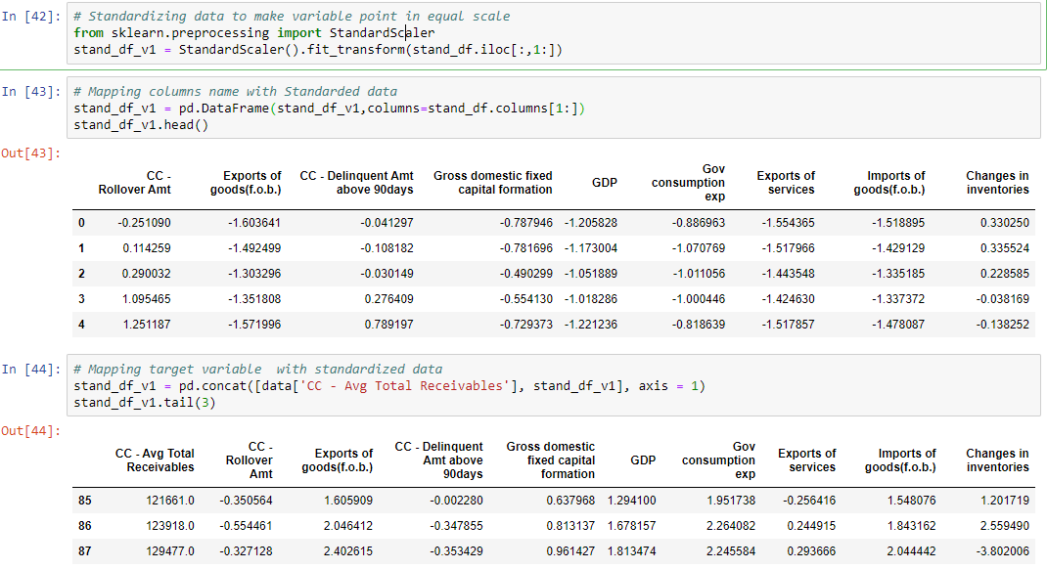
Feature Engineering
Standardization using Standard scaler
Standardization of a dataset is a common requirement for many machine learning estimators: they might behave badly if the individual features do not more or less look like standard normally distributed data
Standardize features by removing the mean and scaling to unit variance.
Notes:
PCA is a dimension technique. The first PC is a linear combination of correlated variables which explains the maximum variance. The second PC is a linear combination of correlated variables which explains the second largest variance and is uncorrelated with the first one. It is a feature extraction technique.

Slide 24
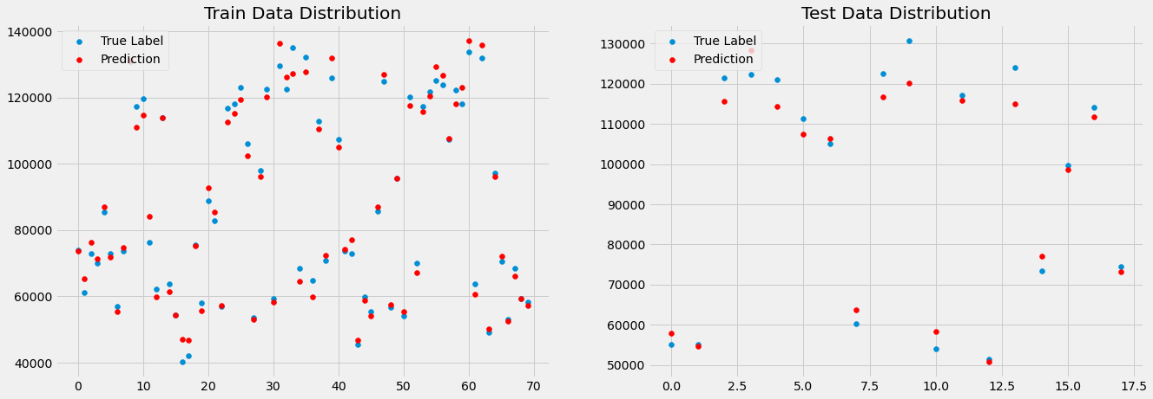
Multiple Linear Regression Analysis Base Line Model
20% of the data is used to create the test data
80% to create the train data
Mean absolute error(MAE), Root-mean-square error(RMSE), R² are metrics used to evaluate regression model
Type | MAE | RMSE | R²
Train data | 2580.15 | 1.040439e+07 | 0.9877
Test data | 3921.58 | 2.366561e+07 | 0.9718
97% of model predictions are correct

Slide 25
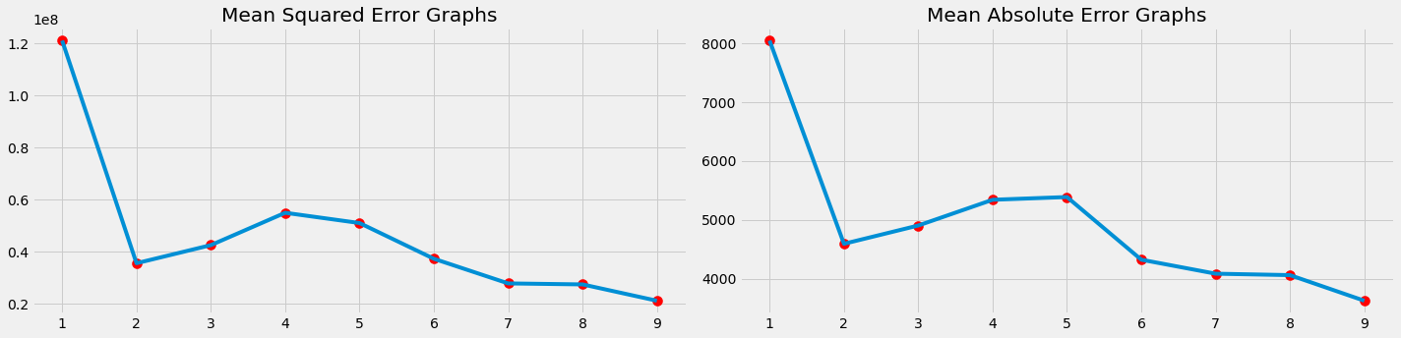
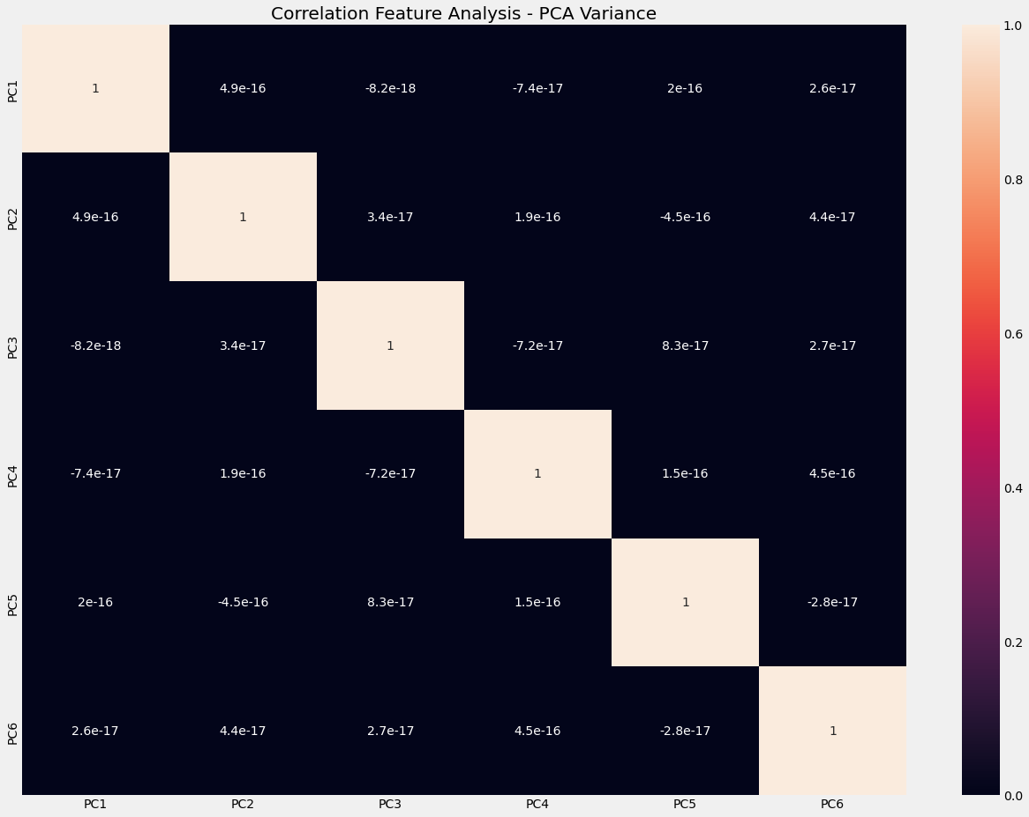
Principal Component Analysis
Implemented dimension reduction technique to reduce the correlation between the pair of variables
MAE and MSE graph shows the model with one PCA component has a high error rate. As we keep adding PCA components the error rate starts reducing.
Chosen the first 6 Principal components for Regression, as it still contains most of the information from the data set.
Corelation plot - do not exhibit a correlation between the pair of variables
Notes:
PCA is a dimension technique. The first PC is a linear combination of correlated variables which explains the maximum variance. The second PC is a linear combination of correlated variables which explains the second largest variance and is uncorrelated with the first one. It is a feature extraction technique.

Slide 26
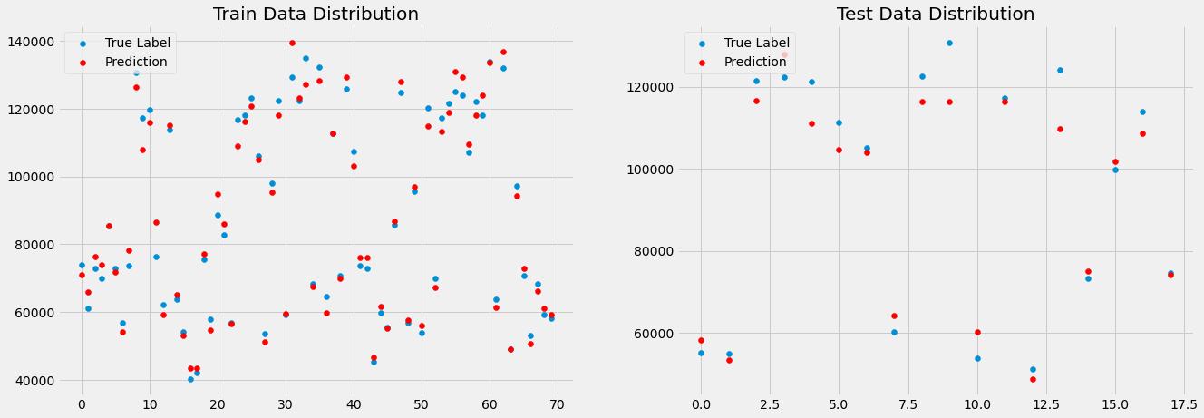
Multiple Linear Regression Analysis with 6 Principal Components
Type | MAE | RMSE | R²
Train data | 3046.14 | 1.450893e+07 | 0.9829
Test data | 5049.911 | 4.216659e+07 | 0.9498
95% of model predictions are correct

Slide 27
Results & Conclusion
 | Metrics | Linear Regression | Decision Tree | Random Forest | Xgboost
Train data | MAE | 3046.14 | 0 | 1068.511749 | 0.010148
 | RMSE | 1.450893e+07 | 0 | 1.896120e+06 | 2.010253e-04
 | R² | 0.9829 | 1.00 | 0.9977 | 1.000000
Test data | MAE | 5049.91 | 2758.9526 | 3018.0768 | 5537.9536
 | RMSE | 4.216659e+07 | 1.370270e+07 | 1.615802e+07 | 7.026508e+07
 | R² | 0.9498 | 0.9836 | 0.9807 | 0.9163
Tried different ML models in addition to linear regression model.
Linear regression is more sustainable as it gives good accuracy over the training data and the test data whereas the other three models are overfitting.

Slide 28
Future Work
More availability of data can help in implementing multiple machine learning models to predict customer behavior on credit card receivables
Banks can survey their credit card customers to know the real-time factors which are affecting the payments to the bank.
The availability of surveyed customer data will help researchers provide useful insights to banks for resolving customer problems towards making the payments
Banks can also start looking more towards analyzing the digital wallet transactions data as this method of payment is likely to surpass credit cards in Hong Kong by 2025
Currently the digital wallets: Alipay, WeChat Pay, Tap & Go and Octopus collectively attracted more than 4.7 million new users and 96,000 new merchants in Hong Kong by the end of 2021

Slide 29


